Slide 1



Operational research for urban solar development
“PV failure detection based on operational time series”
13/11/2024
Alexandre Mathieu

Slide 2
Curriculum
Day | Time | Duration | Content
Wednesday 13/11/2024 | 11h45-12h45 14h15-15h45 | 1h30 + 1h30 | 50% Lecture / 50 % Hands-on
Tuesday 26/11/2024 | 9h45-13h00 | 1h30 + 1h30 | 25% Lecture / 75 % Hands-on
Monday 02/12/2024 | 13h15-16h15 | 3h | 15% Lecture / 85 % Hands-on
Monday 09/12/2024 | 8h-11h 13h15-16h15 | 6h | 10% Lecture / 90 % Hands-on/Project
Tuesday 10/12/2024 | 8h-11h | 3h | 10% Lecture / 90 % Project
Monday 16/12/2024 | 8-11h | 3h | 10% Lecture / 90 % Project
Thursday 19/12/2024 | 9h45-12h45 | 3h | 10% Lecture / 90 % Project
Monday 06/01/2025 | 13h15-14h45 | 1h30 | 100% Project
Monday 13/01/2025 | 9h45-11h45 | 1h30 | 100% Project
Total |  | 27h
Plan

Slide 3
Curriculum
Content
PV performance modeling from weather variables (Irradiance in the plane of array, ambient temperature etc..) and system configuration, which includes:
Module temperature
DC power
AC/DC efficiency
Performance metric calculations.
Failure detection based on real production time series.
Hands-on with python notebooks.

Slide 4
Curriculum
15%[4] of underperformances: « Recoverable » Energy: 5%[4,5]
Complex in-situ O & M: No one-fit-all O&M[2] Expensive[3]
PV capacity increases exponentially
+20%/year worldwide since 2010[1]
Motivations
[1] Masson, G., Kaizuka, I., 2021. Trends in Photovoltaic Applications (IEA-PVPS T1-41:2021). IEA PVPS
[2] U. Jahn et al., ‘Guidelines for Operation and Maintenance of Photovoltaic Power Plants in Different Climates’, IEA, Technical Report IEA-PVPS T13-07:2022, Oct. 2022. [3] « Coûts et rentabilités du grand photovoltaïque en métropole continentale », CRE, 2019
[4] Leloux, J., Narvarte, L., Trebosc, D., 2011. Performance analysis of 10,000 residential PV systems in France and Belgium. Presented at the 26th European Photovoltaic Solar Energy Conference and Exhibition, Hamburg, Germany.) [5] Raycatch, ‘Solar Asset Optimization, Industry Benchmark Study’, Tel Aviv, Israel, Feb. 2021.

Slide 5
Curriculum
Objectives
At the end of this course, you should be able to:
Perform data treatment and analysis with Python on operational PV time series.
Model and calculate the performance of a PV installation.
Detect and quantify underperformances.

Slide 6
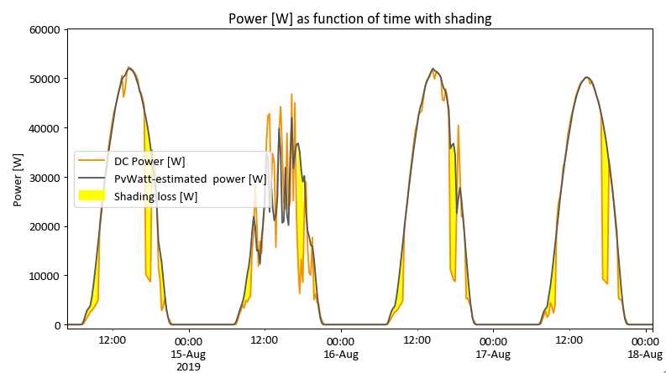
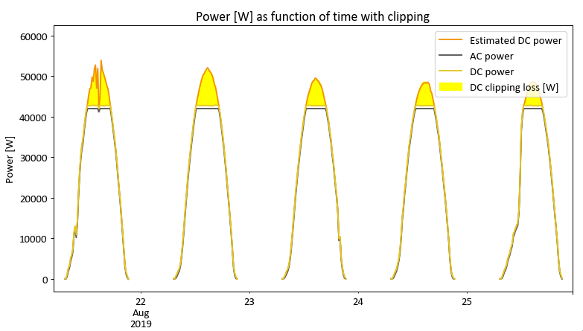
Final project
The project aims at detecting PV underperformances.
2 grades:
Estimation of the operating variables such as POA irradiance, module temperature, DC and AC power from in-situ data.
Loss quantification from some underperformances (shading, clipping, short-circuit…).

Slide 7
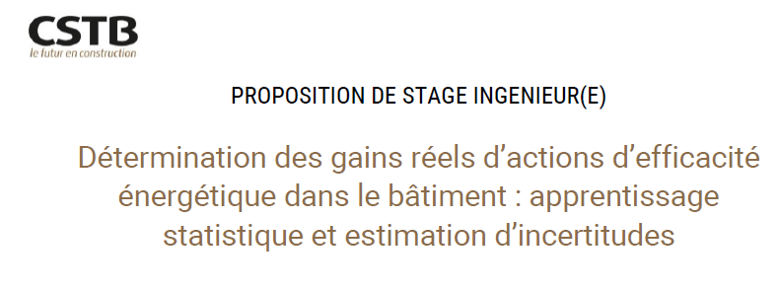
Internship offer
“Assessing Actual Gains of Energy Efficiency Actions in Buildings: Statistical Learning and Uncertainty Estimation”
Early 2025
6 mois
1200eur
Champs-sur Marne
Python / Data-analysis / Machine Learning
thimothee.thiery@cstb.fr

Slide 8
Audience

Slide 9


Audience
You
Background
PV modeling
Python
https://forms.gle/MVFYCf1i7MiT9oGs7
Notes:
Where do you come from ? Education
Expérience with python and PV modeling

Slide 10

Who am I ?
PhD: Methodology development to guarantee building photovoltaic systems’ performance including failure modelling.
Started in March 2022. Aiming to finish in March 2025.
Studied Engineering / Sustainable Energy in France & Denmark.
My personal belief is that research owes to find solutions to mitigate the human environmental impact.
Hobbies:
Mountains
Sports
Travelling
Born in Grenoble, Raised there, Living there…

Slide 11
Agenda
Curriculum
Audience
PV performance model steps

Slide 12

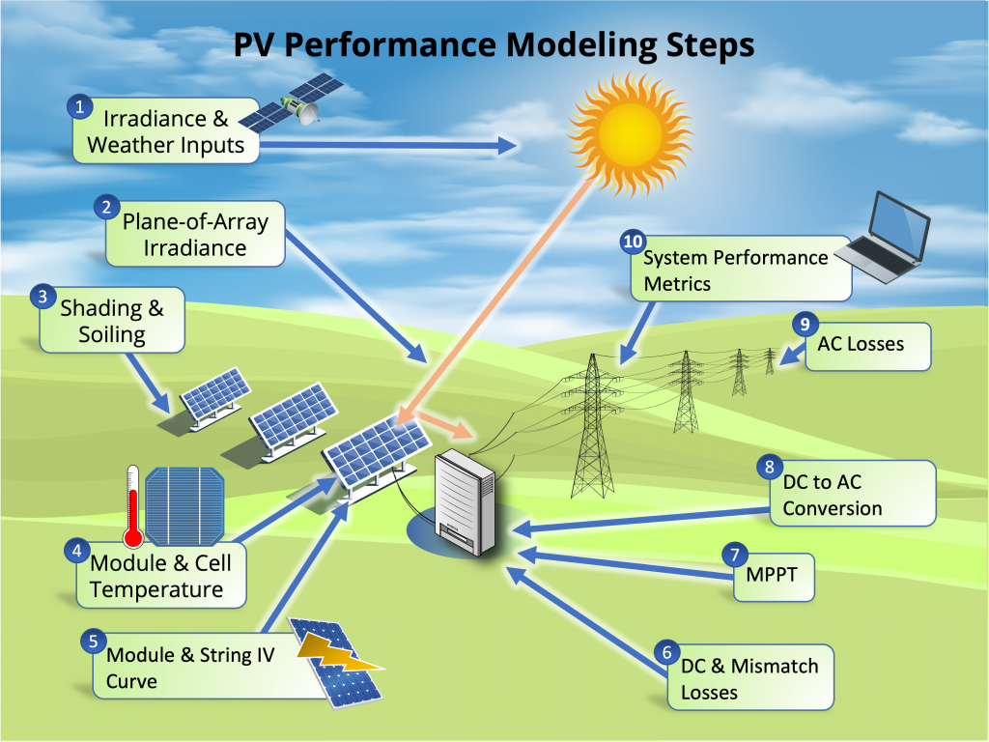
Modeling steps
*image from: PVSC48 python tutorial

Slide 13
Modeling steps
Weather data: Irradiance, ambient temperature, humidity, rain, snow…

Slide 14
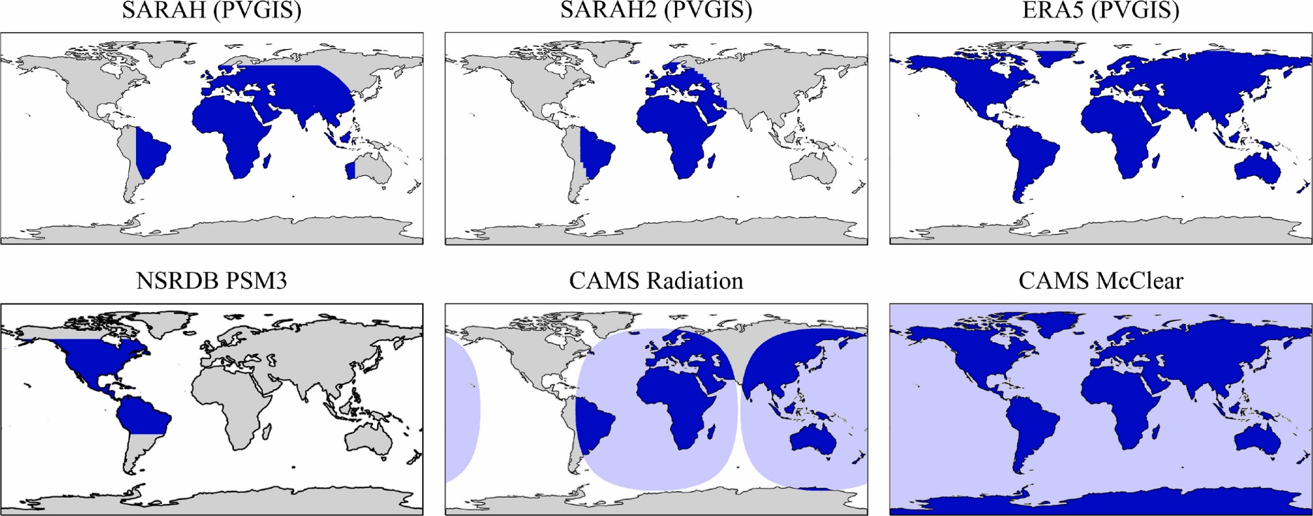
Modeling steps
Some Irradiance datasets, supported by pvlib [1]
Weather data:
Irradiance, measured in W/m2, with max instantaneous values around 1000 W/m2 is obtained from:
Satellite data (CAMS, NSSRDB, SolarGis…)
[1] Adam R. Jensen, Kevin S. Anderson, William F. Holmgren, Mark A. Mikofski, Clifford W. Hansen, Leland J. Boeman, Roel Loonen,
pvlib iotools—Open-source Python functions for seamless access to solar irradiance data, Solar Energy, 2023

Slide 15
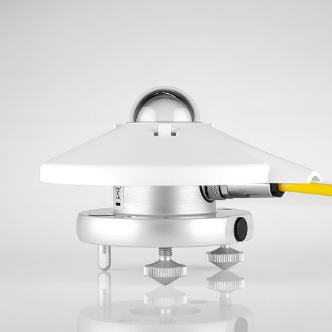
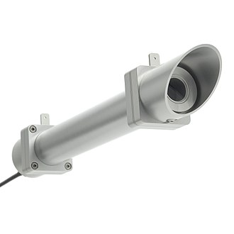
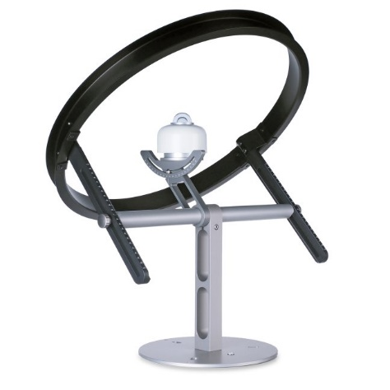
Modeling steps
Weather data:
Irradiance, measured in W/m2, is obtained from:
Satellite data (CAMS, NSSRDB, SolarGis…)
In-situ instrumentations
(Hukseflux product)
Pyranometer: Global/Inclined Irradiance
Pyrheliometer: Direct irradiance
Pyranometer with shadow ring: Diffuse Irradiance

Slide 16
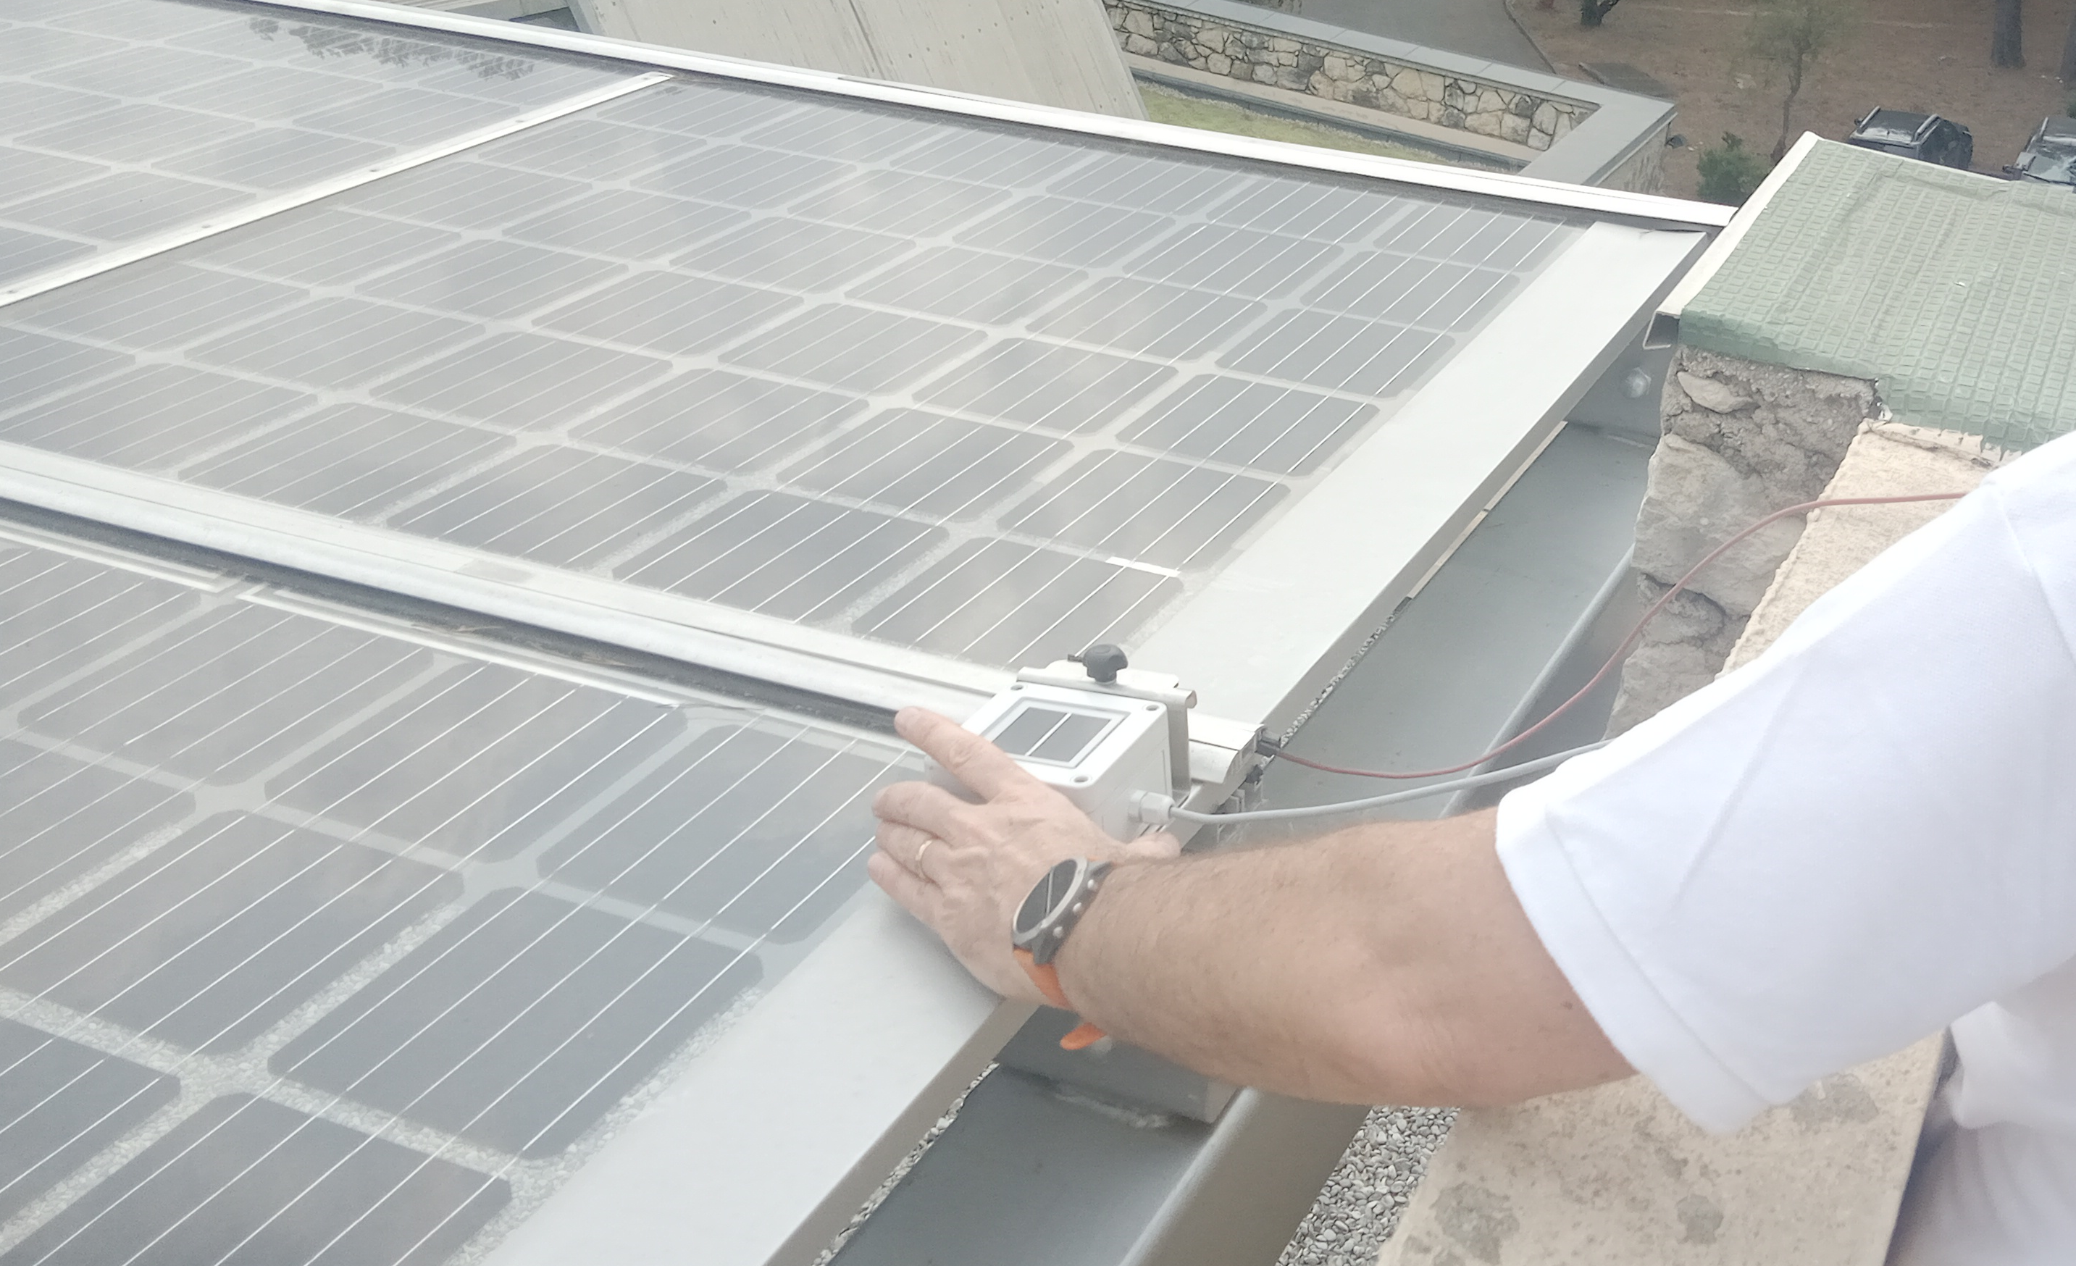
Modeling steps
Weather data:
Irradiance, measured in W/m2, is obtained from:
Satellite data (CAMS, NSSRDB, SolarGis…)
In-situ instrumentations
Reference cell: Inclined Irradiance (without reflection/spectral effects)

Slide 17
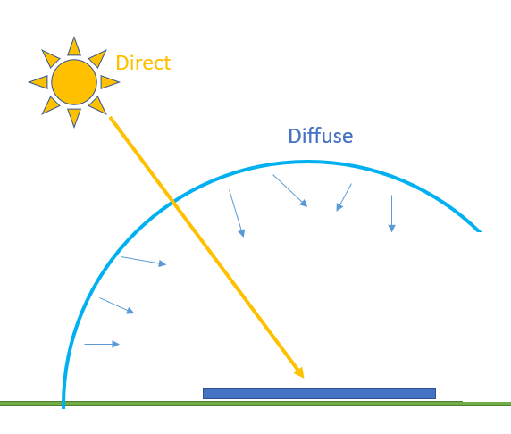
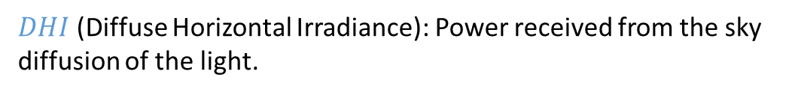
Modeling steps
Weather data
Reminder, the Global Horizontal Irradiance (GHI) can be broken down into 2 components (ignoring reflections from other surrounding elements):
$$GHI=BHI+DHI$$
*image from PVSC48 tutorial
$BHI$ (Beam Horizontal Irradiance): Power received from the Beam of the sun on the horizontal plan.
$DHI$ (Diffuse Horizontal Irradiance): Power received from the sky diffusion of the light.

Slide 18
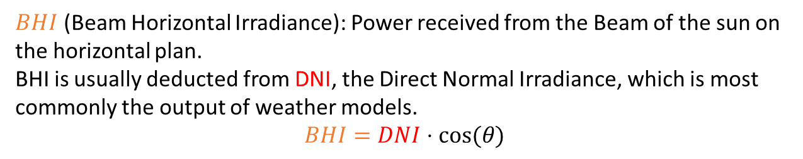
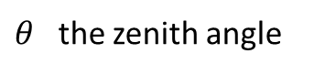
Modeling steps
Weather data
Reminder, the Global Horizontal Irradiance (GHI) can be broken down into 2 components (ignoring reflections from other surrounding elements):
$θ$ the zenith angle
$$GHI=BHI+DHI$$
*image adapted from PVSC48 tutorial
$BHI$ (Beam Horizontal Irradiance): Power received from the Beam of the sun on the horizontal plan. BHI is usually deducted from DNI, the Direct Normal Irradiance, which is most commonly the output of weather models. $$BHI=DNI⋅cos⁡(θ)$$
$DHI$ (Diffuse Horizontal Irradiance): Power received from the sky diffusion of the light.

Slide 19
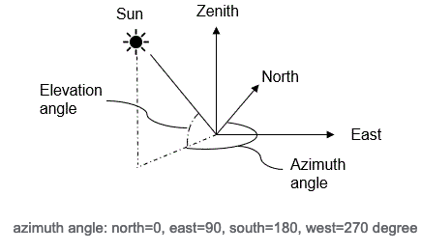
Modeling steps
Weather data:
Sun path
z
Φ
Image: https://www.prairielittlebighouse.com/prairie-blog/archives/03-2021

Slide 20
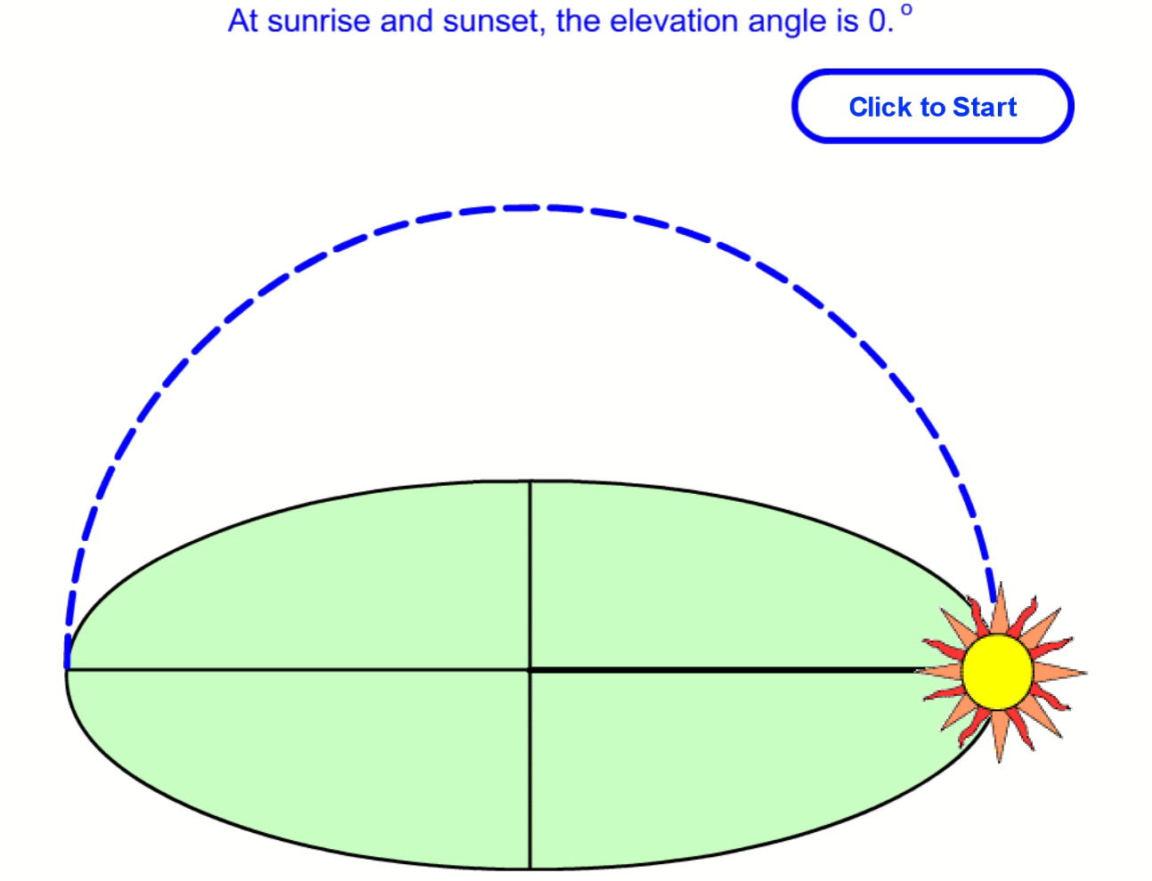
Modeling steps
z
Φ
Weather data:
The sun path is characterized by:
h [°], elevation angle, height of the sun in the sky
*animation from pveducation

Slide 21
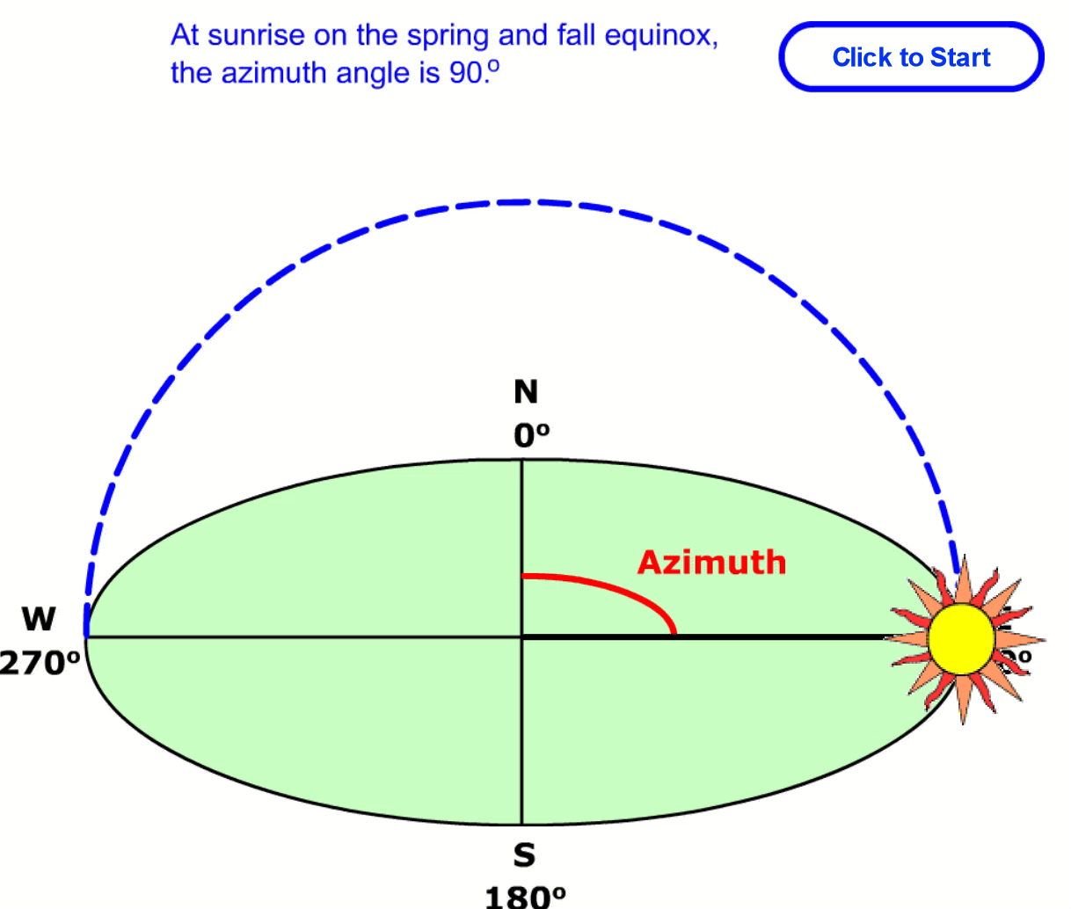
Modeling steps
z
Φ
Weather data:
The sun path is characterized by:
h [°], elevation angle, height of the sun in the sky
Φ [°], the azimuth angle: angle of sun between north and sun direction
*animation from pveducation
*animation from pveducation

Slide 22
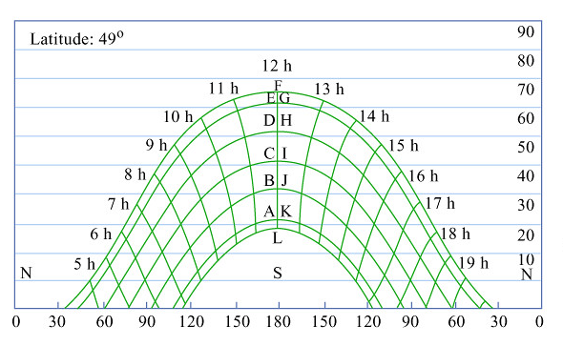
Modeling steps
Typical sun path diagram
Weather data:
The sun path is characterized by:
h [°], elevation angle, height of the sun in the sky
Φ [°], the azimuth angle: angle between north and the sun direction
h [°]
Φ [°]

Slide 23
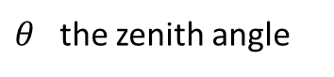
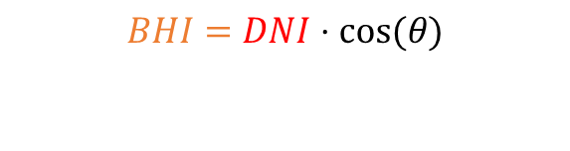
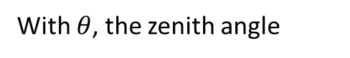
Modeling steps
z
Φ
Weather data:
The sun path is characterized by:
h [°], elevation angle, height of the sun in the sky
Φ [°], the azimuth angle: angle between north and the sun direction
Remember ? To calculate BHI:
$$BHI=DNI⋅cos⁡(θ)$$
$θ$ the zenith angle
With $θ$, the zenith angle
$$θ=90° −h$$
*image adapted from PVSC48 tutorial

Slide 24
Modeling steps
2. Plan-of-Array Irradiance
Reminder, the Global Plane-Of-Array (POA) irradiance can be calculated from DHI, GHI and DNI.

Slide 25
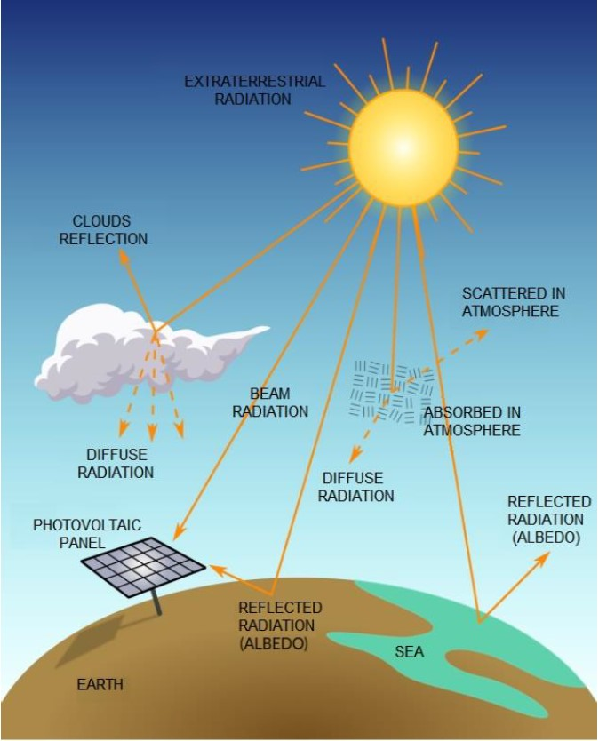
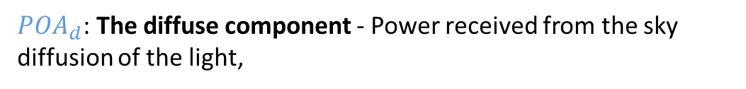
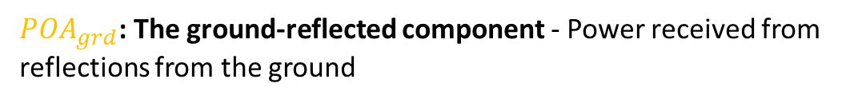
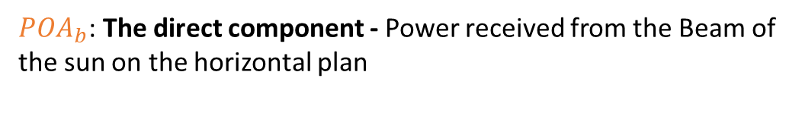
Modeling steps
2. Plan-of-Array Irradiance
Reminder, the Global Plane-Of-Array (POA) irradiance can be calculated from DHI, GHI and DNI and are broken down into 3 components:
$$POA=POA_{b}+POA_{d}+POA_{grd}$$
$POA_{b}$: The direct component - Power received from the Beam of the sun on the horizontal plan
$POA_{d}$: The diffuse component - Power received from the sky diffusion of the light,
$POA_{grd}$: The ground-reflected component - Power received from reflections from the ground
Souza, Muriele et al. (2019). Determination of Diffused Irradiation from Horizontal Global Irradiation - Study for the City of Curitiba.

Slide 26
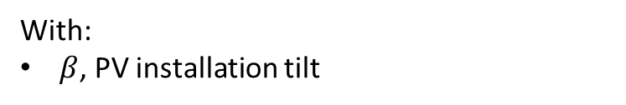
Modeling steps
2. Plan-of-Array Irradiance
Reminder, the Global Plane-Of-Array (POA) irradiance can be calculated from DHI, GHI and DNI and are broken down into 3 components:
$$POA=POA_{b}+POA_{d}+POA_{grd}$$
$POA_{b}=DNI⋅\cos\left(AOI\right)$
Under the isotropic/no-shading assumption
$POA_{d}=DHI⋅\frac{1+cos⁡(β)}{2}$
$POA_{grd}=GHI⋅ρ⋅\frac{1−cos⁡(β)}{2}$
Souza, Muriele et al. (2019). Determination of Diffused Irradiation from Horizontal Global Irradiation - Study for the City of Curitiba.
With:
$β$, PV installation tilt

Slide 27
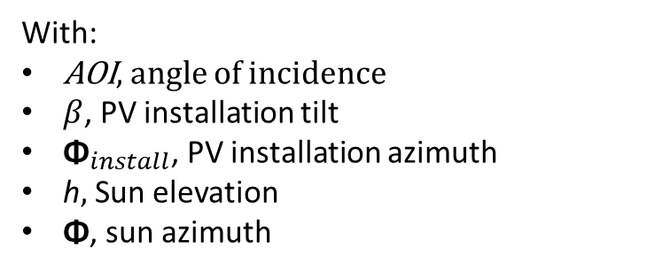

Modeling steps
2. Plan-of-Array Irradiance
Reminder, the Global Plane-Of-Array (POA) irradiance can be calculated from DHI, GHI and DNI and are broken down into 3 components:
$$POA=POA_{b}+POA_{d}+POA_{grd}$$
$POA_{b}=DNI⋅\cos\left(AOI\right)$
$\cos\left(AOI\right)$ = $\left[\cos\left(β\right)∙\sin\left(h\right)+\sin\left(β\right)∙\cos\left(h\right)∙cos⁡(\text{Φ}−{\text{Φ}}_{install})\right]$
Under the isotropic/no-shading assumption
With:
AOI, angle of incidence
$β$, PV installation tilt
${\text{Φ}}_{install}$, PV installation azimuth
h$,$Sun elevation
$\text{Φ}$, sun azimuth
$POA_{d}=DHI⋅\frac{1+cos⁡(β)}{2}$
$POA_{grd}=GHI⋅ρ⋅\frac{1−cos⁡(β)}{2}$

Slide 28

Modeling steps
2. Plan-of-Array Irradiance
Use the notebook: https://github.com/AlexandreHugoMathieu/pvfault_detection_solar_academy/blob/master/notebooks/python_intro_poa.ipynb
Follow the python tutorial and calculate the 3 POA components for:
One timestep
Over one year
Time for some hands-on exercises

Slide 29
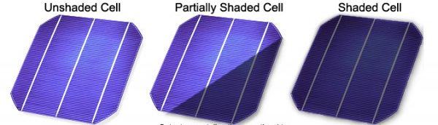
Modeling steps
3. Shading
Shadow can come from near and far elements and their impact can be distinguished into two categories
Partial shading refers to a condition where some but not all of the solar cells or panels in a PV array are exposed to sunlight while others are shaded.
Full shading occurs when the entire PV array is covered and deprived of direct sunlight.
*https://mcisolutions.ca/effect-of-shade-on-solar-panels/

Slide 30
Modeling steps
3. Shading
Shadow can come from near and far elements and their impact can be distinguished into two categories
Partial shading refers to a condition where some but not all of the solar cells or panels in a PV array are exposed to sunlight while others are shaded.
Full shading occurs when the entire PV array is covered and deprived of direct sunlight.
Not treated in this course but, in average, if a PV panel is around 8% covered, bypass diodes start to activate and **might** reduce the whole module production.
Demonstrated in one of pvlib example: https://pvlib-python.readthedocs.io/en/stable/gallery/shading/plot_partial_module_shading_simple.html
*https://mcisolutions.ca/effect-of-shade-on-solar-panels/

Slide 31
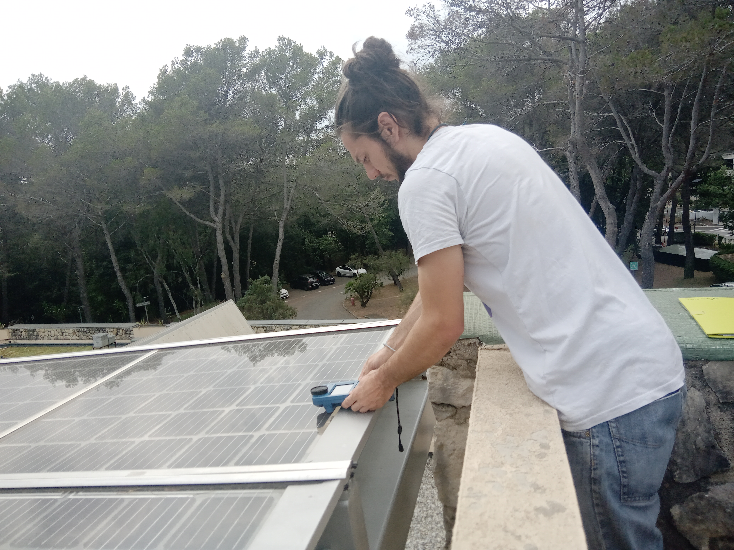
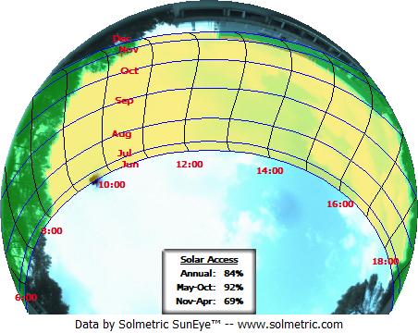
Modeling steps
Fisheye camera
3. Shading
The Fisheye camera enables to account for the in-situ (full) shading in PV modeling.
South
East
West
North
Example in South of France

Slide 32
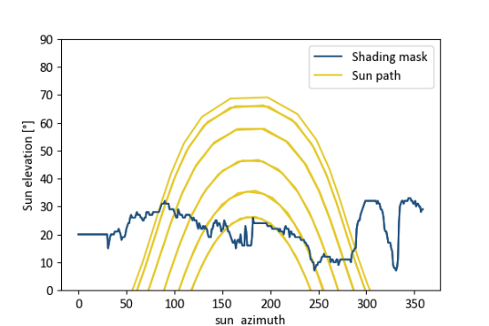
Modeling steps
Fisheye camera
3. Shading
The Fisheye camera enables to account for the in-situ (full) shading in PV modeling.
South
East
West
North
Example in South of France

Slide 33
Modeling steps
South
East
West
North
Example in South of France

Slide 34
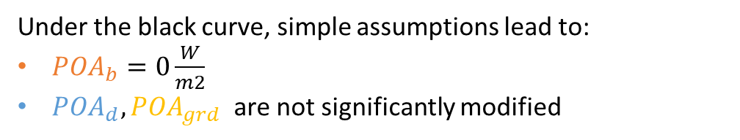
Modeling steps
3. Shading
The Fisheye camera enables to account for the in-situ (full) shading in PV modeling.
Under the black curve, simple assumptions lead to:
$POA_{b}=0\frac{W}{m2}$
$POA_{d}, POA_{grd}$ are not significantly modified
South
East
West
North
Example in South of France

Slide 35
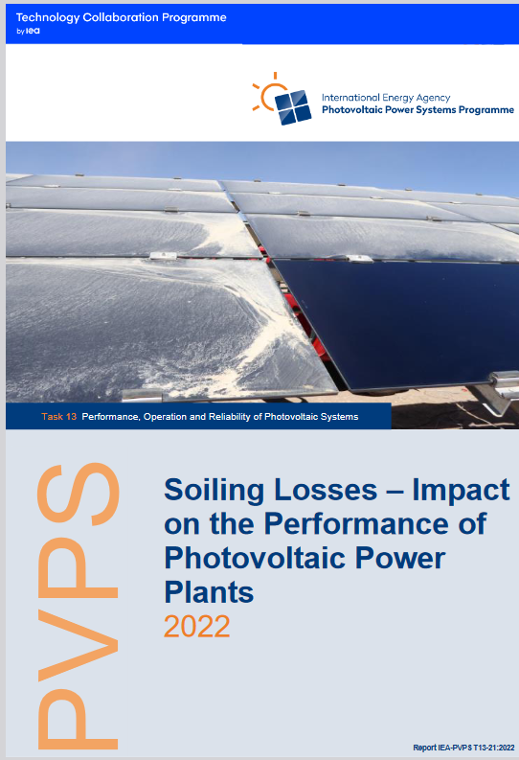
Modeling steps
3. Soiling losses
Big subject in the PV industry:
Report of 130 pages on PV soiling: IEA PVPS, Soiling Losses – Impact on the Performance of Photovoltaic Power Plants 2022

Slide 36
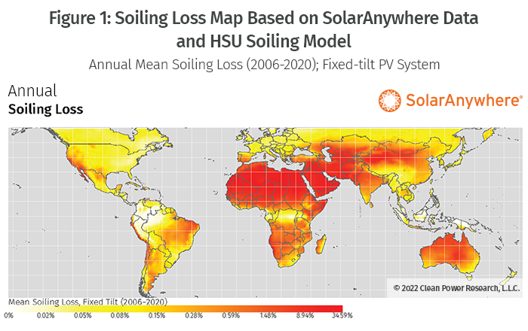
Modeling steps
3. Soiling losses
Can roughly be ignored in France according to the HSU model.
Model HSU: M. Coello and L. Boyle, "Simple Model for Predicting Time Series Soiling of Photovoltaic Panels, Sept. 2019.

Slide 37
Modeling steps
3. Shading / Terrain horizon mask
Time for some hands-on exercises,
Again!

Slide 38
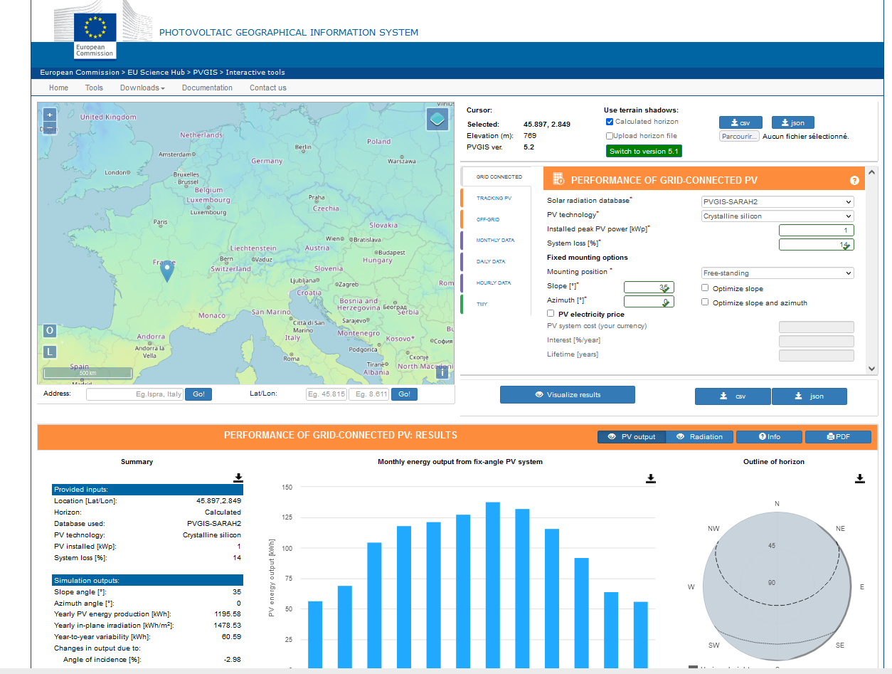
Modeling steps
3. Shading / Terrain horizon mask
PVGIS: Website/Online Tool to estimate power production: https://re.jrc.ec.europa.eu/pvg_tools/en/
Enables to extract the horizon mask with a Digital Surface Model (DSM).
Instructions:
Generate a simulation on PVGIS
Click on the map on Grenoble and select the « Grid connected tab »
Vizualize
Extract the horizon file in csv format
2. Follow the instructions on the jupyter notebook and calculate the modified POA on one year. https://github.com/AlexandreHugoMathieu/pvfault_detection_solar_academy/blob/master/notebooks/python_intro2_horizon_mask.ipynb
Notes:
Show function
Create function to get the API horizon mask
How many hours is the direct component blocked ?

Slide 39
Resources
Modeling guide PVPMC: https://pvpmc.sandia.gov/modeling-guide/
Python / Pvlib tutorial: https://pvsc-python-tutorials.github.io/PVSC48-Python-Tutorial/
To go further:
The Use of Advanced Algorithms in PV Failure Monitoring: https://iea-pvps.org/wp-content/uploads/2021/10/Final-Report-IEA-PVPS-T13-19_2021_PV-Failure-Monitoring.pdf

Slide 40
That’s it

Slide 41
Modeling steps
3. Shading / Terrain horizon mask
PVGIS: Website/Online Tool to estimate power production:
Enables to extract the horizon mask with a Digital Surface Model (DSM).
Go to: https://re.jrc.ec.europa.eu/pvg_tools/en/
Time for some hands-on exercises,
Again !

Slide 42
Resources to go further
Modeling guide PVPMC: https://pvpmc.sandia.gov/modeling-guide/
Python / Pvlib tutorial: https://pvsc-python-tutorials.github.io/PVSC48-Python-Tutorial/
To go further:
The Use of Advanced Algorithms in PV Failure Monitoring , IEA PVPS 2021: https://iea-pvps.org/wp-content/uploads/2021/10/Final-Report-IEA-PVPS-T13-19_2021_PV-Failure-Monitoring.pdf
Improving Efficiency of PV Systems Using Statistical Performance Monitoring, IEA PVPS 2017: https://iea-pvps.org/wp-content/uploads/2020/01/Report_IEA-PVPS_T13-07_2017_Improving_Efficiency_of_PV_Systems_Using_Statistical__Performance_Monitoring.pdf

